Slide 1
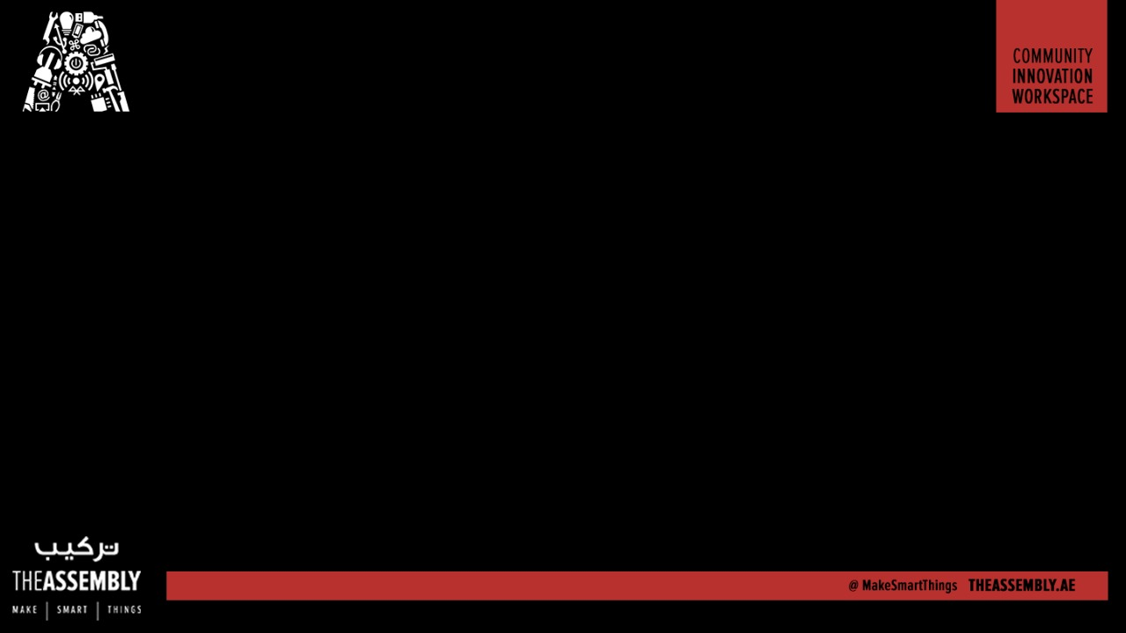
Control your Smart Home using a TV Remote
Presented By : The Assembly Team
Wifi:- In5
Pass:- WelcomeToIn5

Slide 2
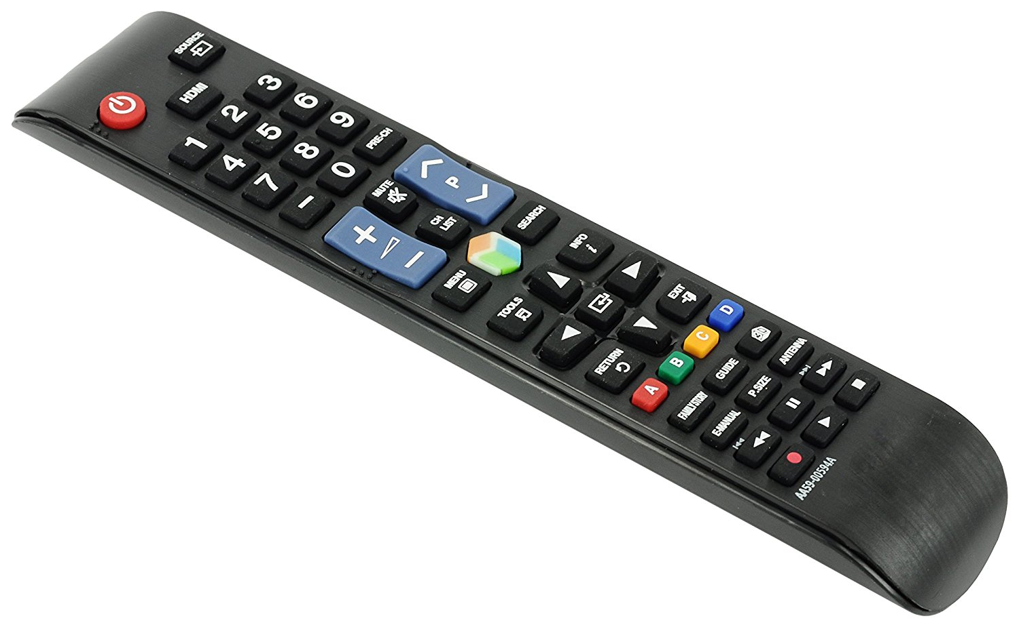
Why a Remote??
Cheap and reliable
Requires less maintenance
Can be used for multiple devices
Easy to setup and operate

Slide 3
Why not to use
Needs Line of sight
Low to Medium range

Slide 4
How does a Remote work?
Notes:
*The HC-06 acts as a serial port through which you can send and receive data.
*So using a serial terminal or a Bluetooth customized application on your computer or phone, you can control and monitor your project.
*HC06 functions only as slave to a microcontroller

Slide 5
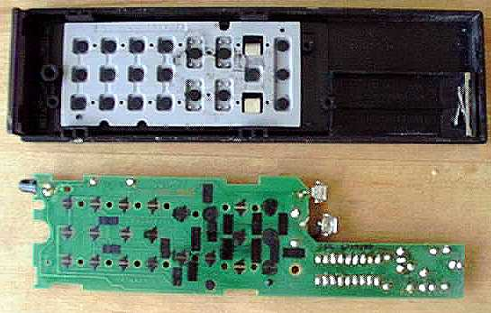

Slide 6


Slide 7
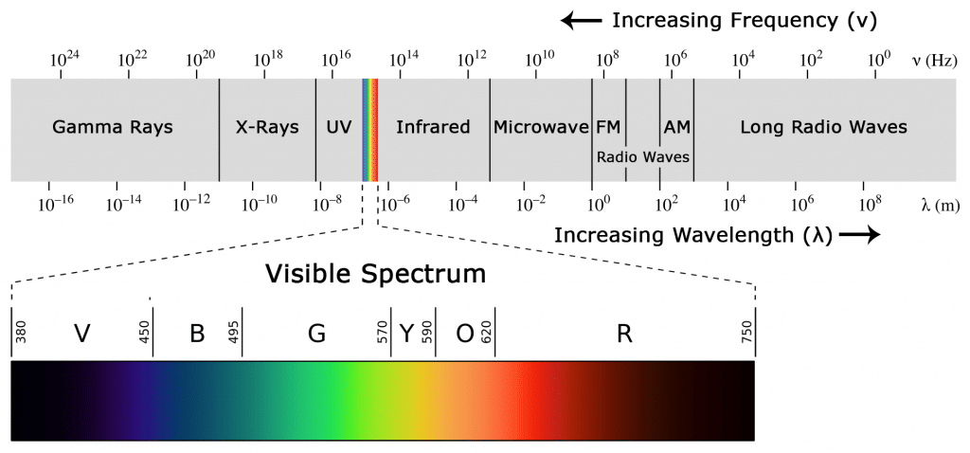

Slide 8
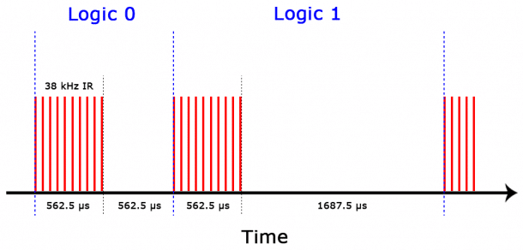

Slide 9
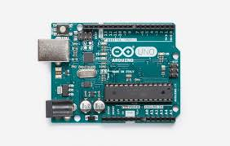
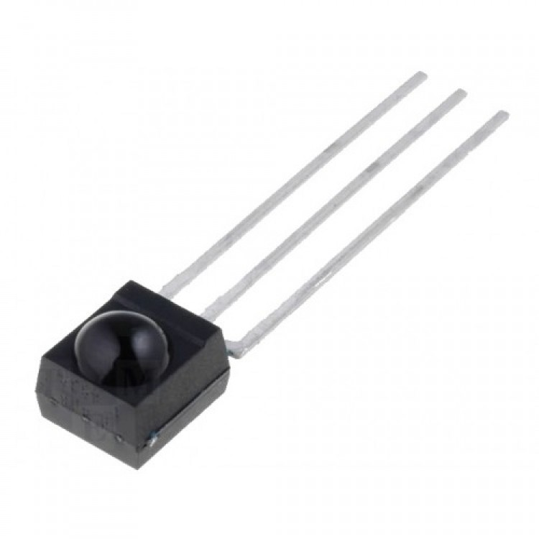
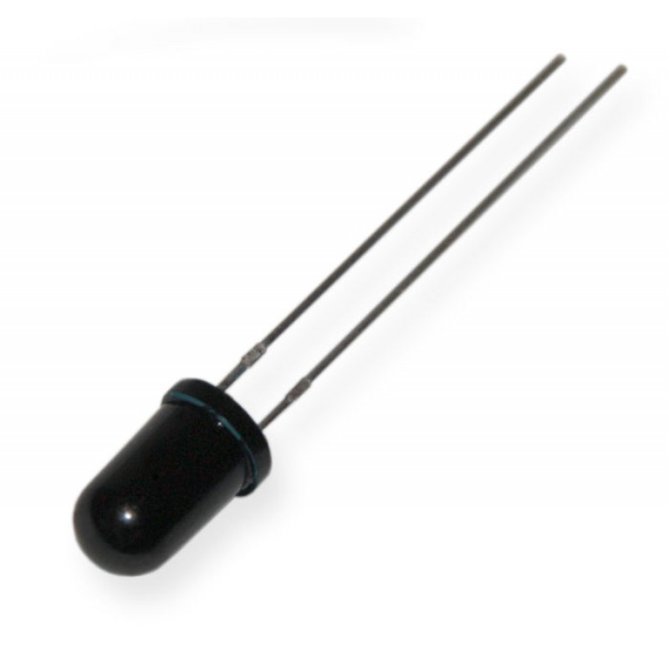
Components
Arduino Uno
Infrared Receiver
Notes:
Polylactic Acid (PLA)
Acrylonitrile butadiene styrene (ABS)

Slide 10
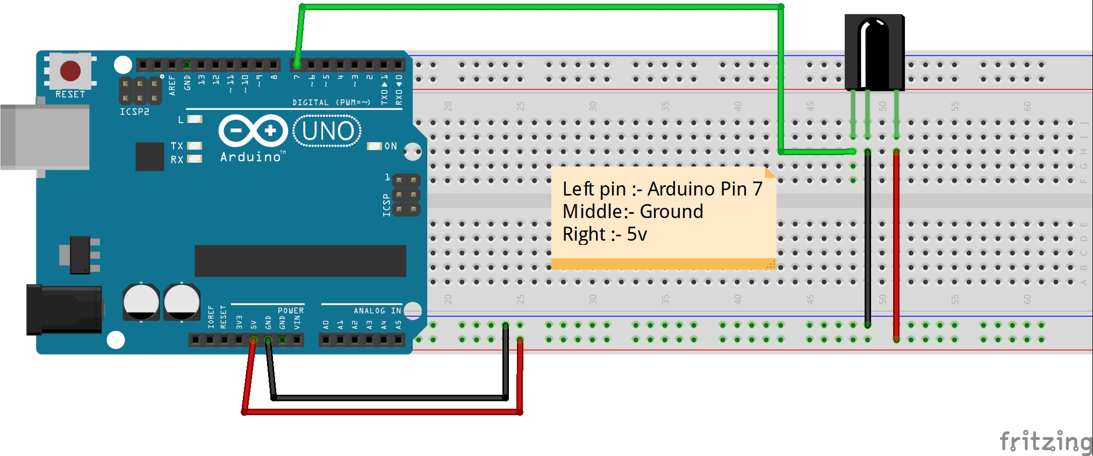

Slide 11
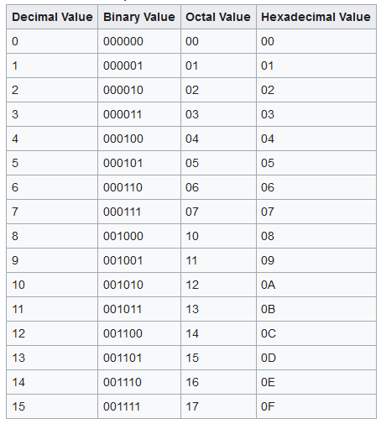

Slide 13

THANK YOU

